Slide 1
Expert System
Dr. Rana Majumdar

Slide 2
In artificial intelligence, an expert system is a computer system that emulates the decision-making ability of a human expert.
Expert systems are designed to solve complex problems by reasoning through bodies of knowledge, represented mainly as if-then rules rather than through conventional procedural code.

Slide 3
An expert system is a computer program that is designed to solve complex problems and to provide decision-making ability like a human expert.
It performs this by extracting knowledge from its knowledge base using the reasoning and inference rules according to the user queries.

Slide 4
The system helps in decision making for complex problems using both facts and heuristics like a human expert.
It is called so because it contains the expert knowledge of a specific domain and can solve any complex problem of that particular domain.
These systems are designed for a specific domain, such as medicine, science, etc.

Slide 5
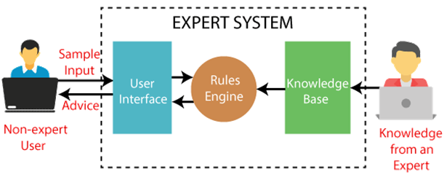
It is important to remember that an expert system is not used to replace the human experts; instead, it is used to assist the human in making a complex decision. These systems do not have human capabilities of thinking and work on the basis of the knowledge base of the particular domain.

Slide 6
Some popular examples of the Expert System
DENDRAL: It was an artificial intelligence project that was made as a chemical analysis expert system. It was used in organic chemistry to detect unknown organic molecules with the help of their mass spectra and knowledge base of chemistry.
MYCIN: It was one of the earliest backward chaining expert systems that was designed to find the bacteria causing infections like bacteraemia and meningitis. It was also used for the recommendation of antibiotics and the diagnosis of blood clotting diseases.
PXDES: It is an expert system that is used to determine the type and level of lung cancer. To determine the disease, it takes a picture from the upper body, which looks like the shadow. This shadow identifies the type and degree of harm.

Slide 7
Characteristics of Expert System
High Performance: The expert system provides high performance for solving any type of complex problem of a specific domain with high efficiency and accuracy.
Understandable: It responds in a way that can be easily understandable by the user. It can take input in human language and provides the output in the same way.
Reliable: It is much reliable for generating an efficient and accurate output.
Highly responsive: ES provides the result for any complex query within a very short period of time.

Slide 8
Components of Expert System
An expert system mainly consists of three components:
User Interface
Inference Engine
Knowledge Base

Slide 9
User Interface
With the help of a user interface, the expert system interacts with the user, takes queries as an input in a readable format, and passes it to the inference engine.
After getting the response from the inference engine, it displays the output to the user. In other words, it is an interface that helps a non-expert user to communicate with the expert system to find a solution.

Slide 10
Inference Engine(Rules of Engine)
The inference engine is known as the brain of the expert system as it is the main processing unit of the system. It applies inference rules to the knowledge base to derive a conclusion or deduce new information. It helps in deriving an error-free solution of queries asked by the user.
With the help of an inference engine, the system extracts the knowledge from the knowledge base.
There are two types of inference engine:
Deterministic Inference engine: The conclusions drawn from this type of inference engine are assumed to be true. It is based on facts and rules.
Probabilistic Inference engine: This type of inference engine contains uncertainty in conclusions, and based on the probability.
Inference engine uses the below modes to derive the solutions:
Forward Chaining: It starts from the known facts and rules, and applies the inference rules to add their conclusion to the known facts.
Backward Chaining: It is a backward reasoning method that starts from the goal and works backward to prove the known facts.

Slide 11
Knowledge Base
The knowledgebase is a type of storage that stores knowledge acquired from the different experts of the particular domain. It is considered as big storage of knowledge. The more the knowledge base, the more precise will be the Expert System.
It is similar to a database that contains information and rules of a particular domain or subject.
One can also view the knowledge base as collections of objects and their attributes. Such as a Lion is an object and its attributes are it is a mammal, it is not a domestic animal, etc.
Components of Knowledge Base
Factual Knowledge: The knowledge which is based on facts and accepted by knowledge engineers comes under factual knowledge.
Heuristic Knowledge: This knowledge is based on practice, the ability to guess, evaluation, and experiences.
Knowledge Representation: It is used to formalize the knowledge stored in the knowledge base using the If-else rules.
Knowledge Acquisitions: It is the process of extracting, organizing, and structuring the domain knowledge, specifying the rules to acquire the knowledge from various experts, and store that knowledge into the knowledge base.

Slide 12
Expert System Technology
Expert System Development Environment − The ES development environment includes hardware and tools. They are −
Workstations, minicomputers, mainframes.
High level Symbolic Programming Languages such as List Programming (LISP) and Programming Logic (PROLOG).
Large databases.
Tools − They reduce the effort and cost involved in developing an expert system to large extent.
Powerful editors and debugging tools with multi-windows.
They provide rapid prototyping
Have Inbuilt definitions of model, knowledge representation, and inference design.
Shells − A shell is nothing but an expert system without knowledge base. A shell provides the developers with knowledge acquisition, inference engine, user interface, and explanation facility. For example, few shells are given below −
Java Expert System Shell (JESS) that provides fully developed Java API for creating an expert system.

Slide 13
Development of Expert Systems: General Steps
The process of ES development is iterative. Steps in developing the ES include −
Identify Problem Domain
The problem must be suitable for an expert system to solve it.
Find the experts in task domain for the ES project.
Establish cost-effectiveness of the system.
Design the System
Identify the ES Technology
Know and establish the degree of integration with the other systems and databases.
Realize how the concepts can represent the domain knowledge best.

Slide 14
Develop the Prototype
From Knowledge Base: The knowledge engineer works to −
Acquire domain knowledge from the expert.
Represent it in the form of If-THEN-ELSE rules.
Test and Refine the Prototype
The knowledge engineer uses sample cases to test the prototype for any deficiencies in performance.
End users test the prototypes of the ES.
Develop and Complete the ES
Test and ensure the interaction of the ES with all elements of its environment, including end users, databases, and other information systems.
Document the ES project well.
Train the user to use ES.

Slide 15
Maintain the System
Keep the knowledge base up-to-date by regular review and update.
Cater for new interfaces with other information systems, as those systems evolve.

Slide 16
Bayes' theorem
Bayes' theorem is also known as Bayes' rule, Bayes' law, or Bayesian reasoning, which determines the probability of an event with uncertain knowledge.
In probability theory, it relates the conditional probability and marginal probabilities of two random events.

Slide 17
It is a way to calculate the value of P(B|A) with the knowledge of P(A|B).
Bayes' theorem allows updating the probability prediction of an event by observing new information of the real world.
Bayes' theorem can be derived using product rule and conditional probability of event A with known event B:
P(A ⋀ B)= P(A|B) P(B)
Similarly, the probability of event B with known event A:
P(A ⋀ B)= P(B|A) P(A)

Slide 18

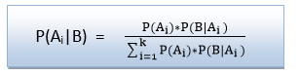
Bayes' rule or Bayes' theorem. This equation is basic of most modern AI systems for probabilistic inference.
It shows the simple relationship between joint and conditional probabilities. Here,
P(A|B) is known as posterior, which we need to calculate, and it will be read as Probability of hypothesis A when we have occurred an evidence B.
P(B|A) is called the likelihood, in which we consider that hypothesis is true, then we calculate the probability of evidence.
P(A) is called the prior probability, probability of hypothesis before considering the evidence
P(B) is called marginal probability, pure probability of an evidence.
Bayes' rule can be written as:

Slide 19
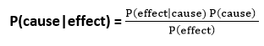
Bayes' rule allows us to compute the single term P(B|A) in terms of P(A|B), P(B), and P(A). This is very useful in cases where we have a good probability of these three terms and want to determine the fourth one. Suppose we want to perceive the effect of some unknown cause, and want to compute that cause, then the Bayes' rule becomes:

Slide 20
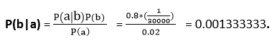
Question: what is the probability that a patient has diseases meningitis with a stiff neck?
Given Data:
A doctor is aware that disease meningitis causes a patient to have a stiff neck, and it occurs 80% of the time. He is also aware of some more facts, which are given as follows:
The Known probability that a patient has meningitis disease is 1/30,000.
The Known probability that a patient has a stiff neck is 2%.
Let a be the proposition that patient has stiff neck and b be the proposition that patient has meningitis. , so we can calculate the following as:
P(a|b) = 0.8
P(b) = 1/30000
P(a)= .02
Hence, we can assume that 1 patient out of 750 patients has meningitis disease with a stiff neck.

Slide 21
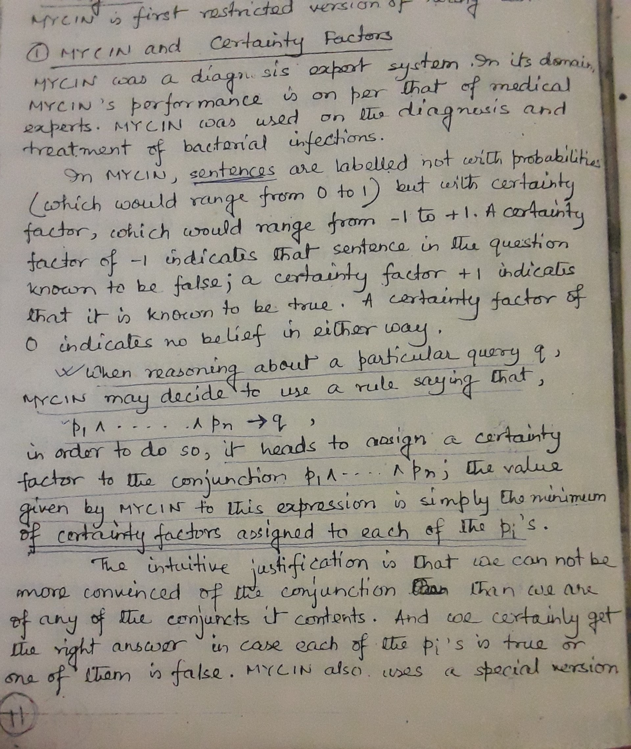

Slide 22
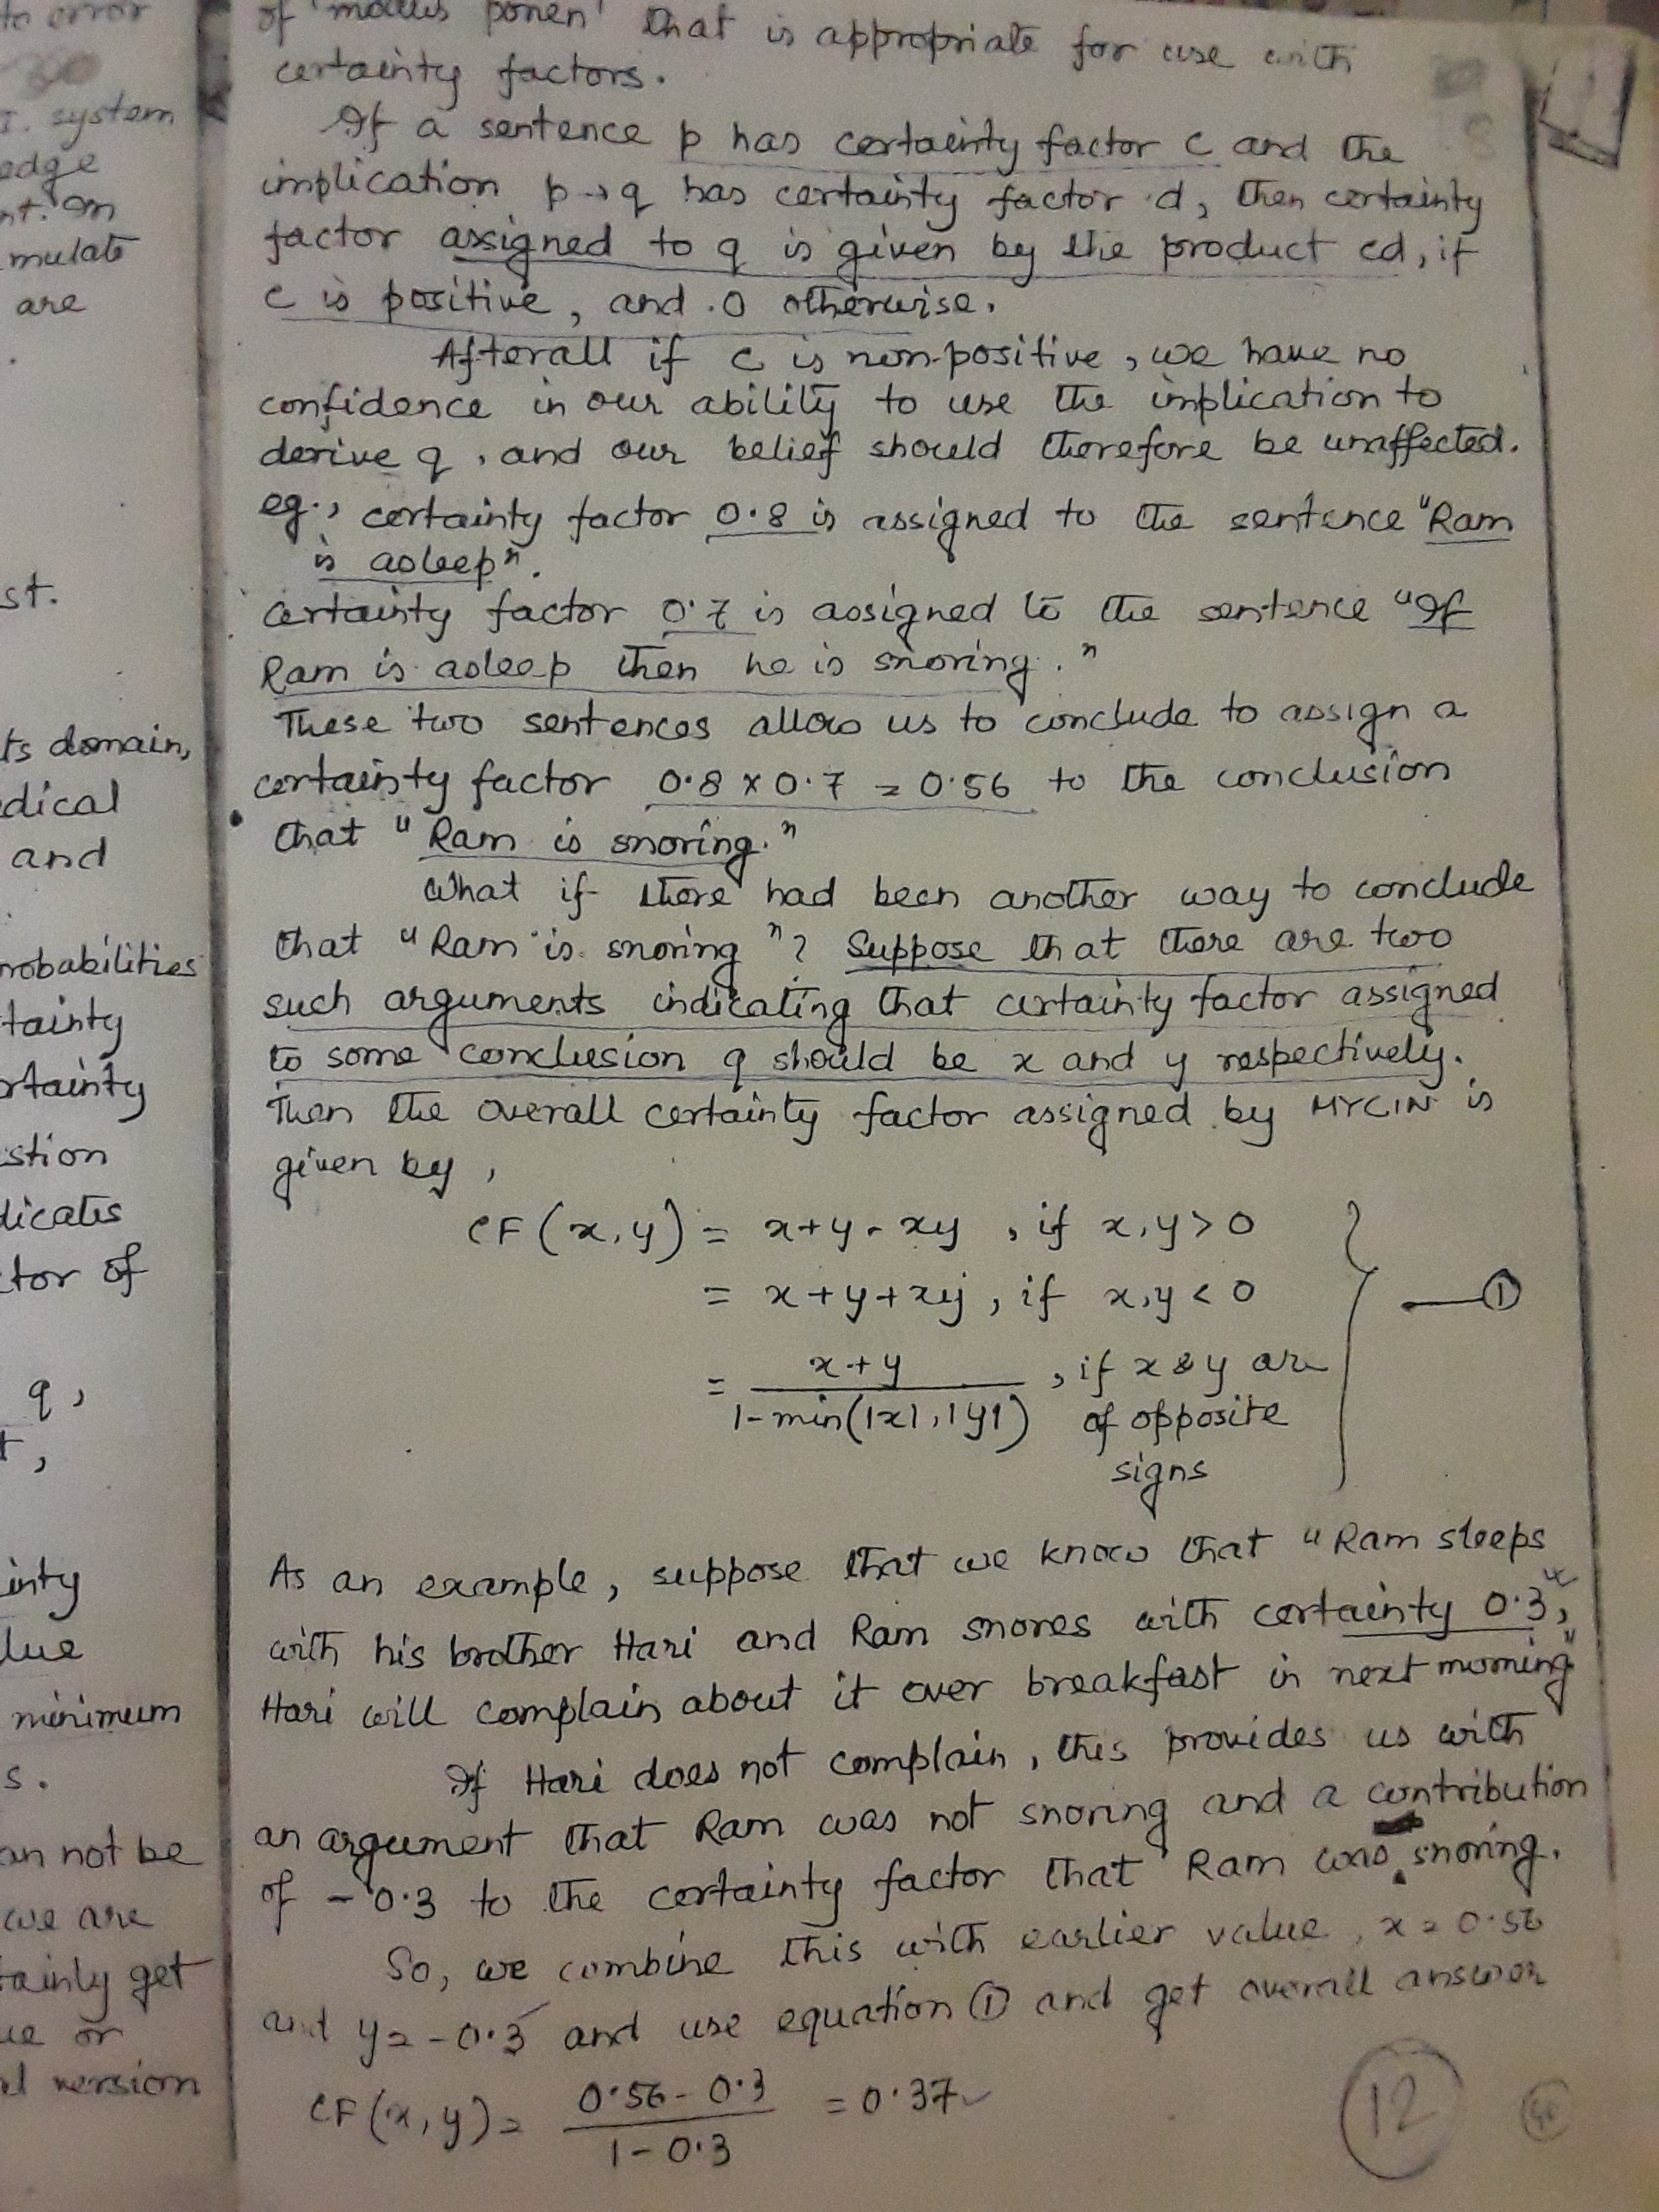

Slide 23
